Slide 1
Aarya
A Kinesthic Companion for ASD affected children

Slide 2
Problem Statement
Children with Autism Spectrum Disorder (ASD) exhibit a range of developmental disabilities, with mild to severe effects in social interaction and communication.
Interaction of children with ASD and virtual environments has been reported to be beneficial in acquisition of social skills.
Our application works as a personal well being companion to children with ASD while they interact with a virtual environment that is gesture based.

Slide 3
Motivation
By making an Autistic child face a real situation we can improve his/her confidence in facing the world and being open to learning various skills.
Social interaction and communication have been reported as the major challenges faced by the children with ASD.
It has been found that games and Virtual Reality can be used to improve the capabilities of individuals with ASD and help them live more independently.

Slide 4
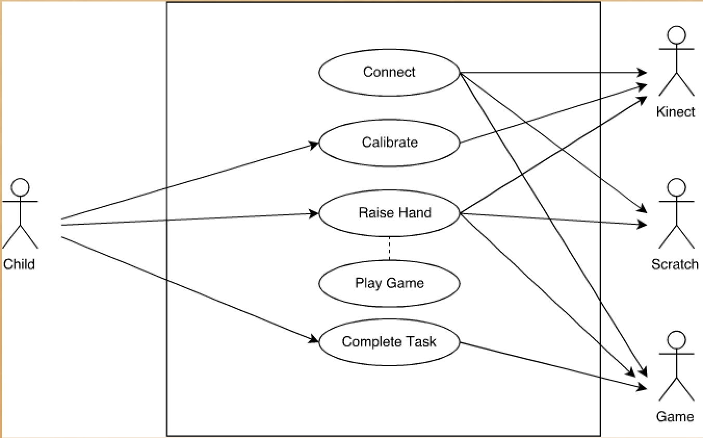
Use Case Diagram

Slide 5
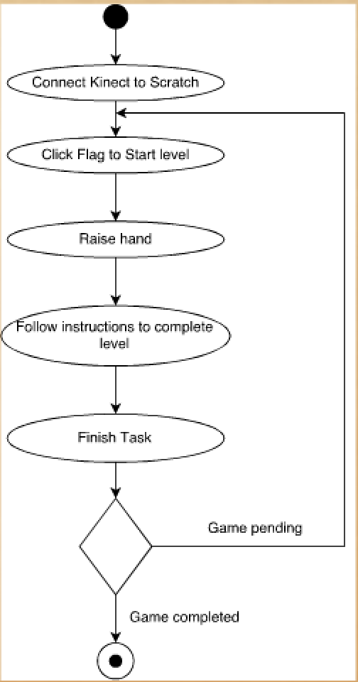
Activity Diagram

Slide 6
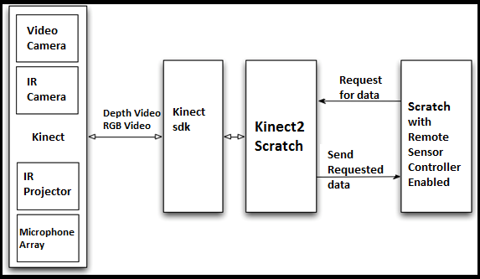
Kinect Detailed Design

Slide 7
DEMO

Slide 8
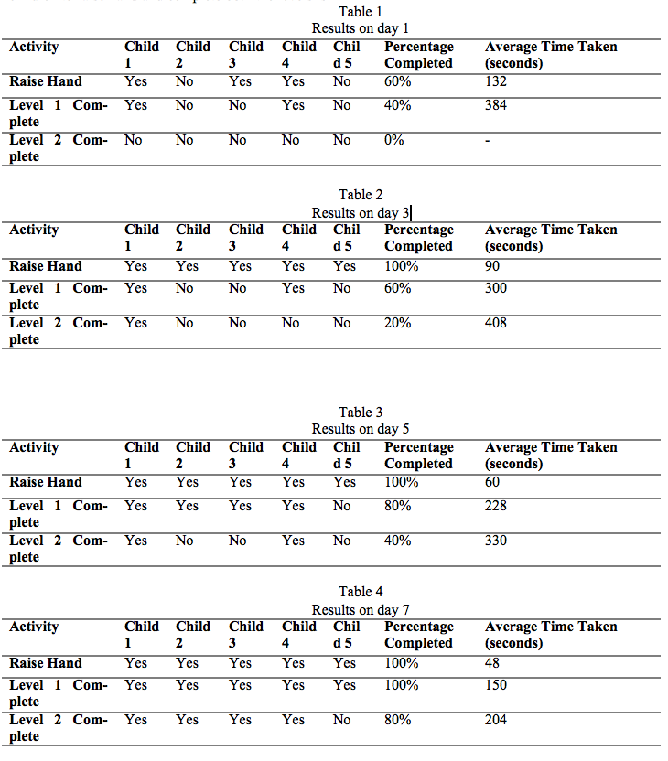
Results

Slide 9
Q&A?

